Slide 1

Customer Retention Data Analysis

Slide 2
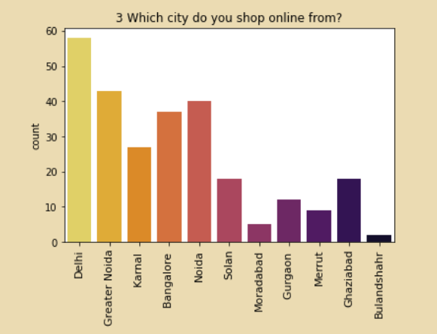
People from Delhi are using online platform the most.

Slide 3
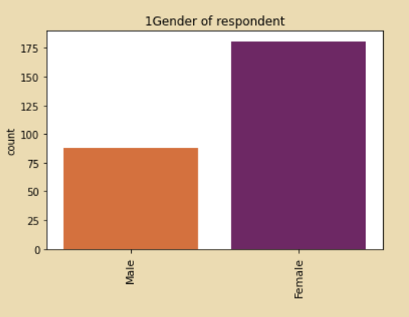
The number of female customers are greater than male customers in the dataset. The reason can be female tend to shop more on a daily basis.

Slide 4
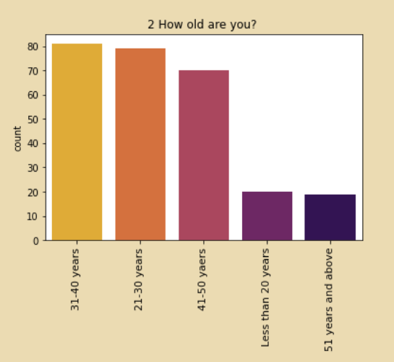
People of age group between 21-50 years are shopping the most. Whereas the Customers below 20 and above 51 years are shopping less .

Slide 5
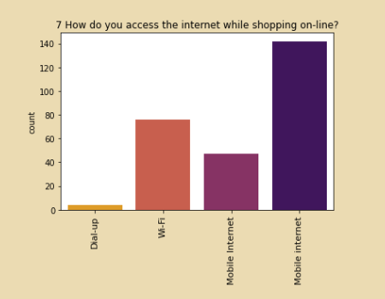
Mobile Internet is the way people access the internet while shopping online.

Slide 6
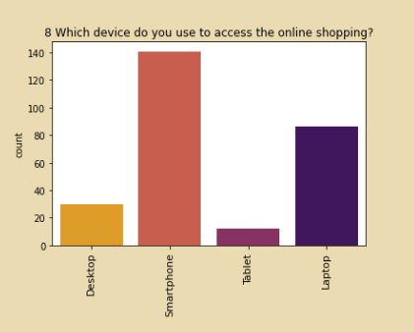
Smartphones are used the more frequent while shopping online.

Slide 7
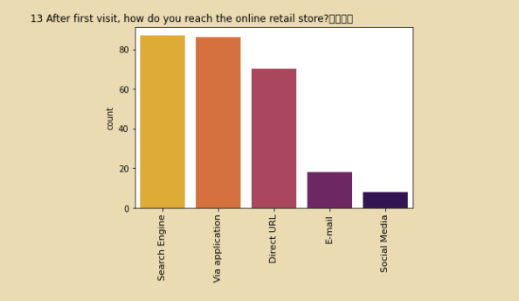
People tend to use Search Engine, Application and direct URL
to reach the online store . Whereas Email and social media are
not preferred that much.

Slide 8
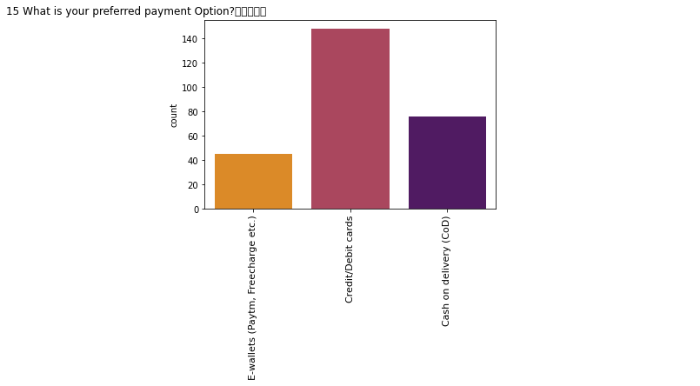
People like to pay the bill using Cards the most.

Slide 9
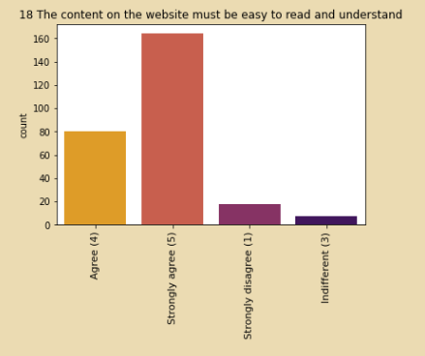
Users want that the content on the website must be easy to read and understand.

Slide 10
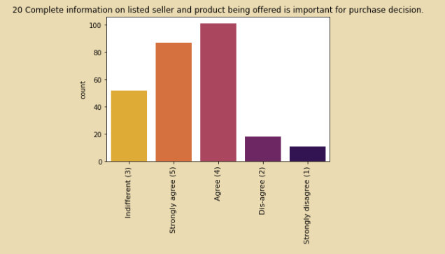
Users want that complete information on listed seller and product should
be there but there are users that are indifferent to this.

Slide 11
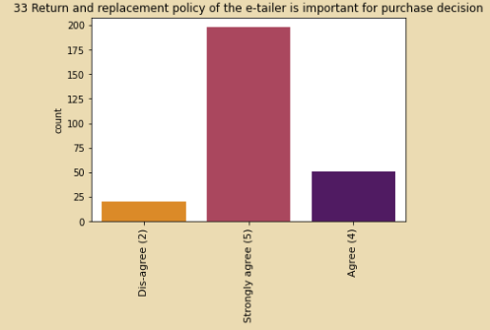
Users think that return and replacement policy is important for purchase .

Slide 12
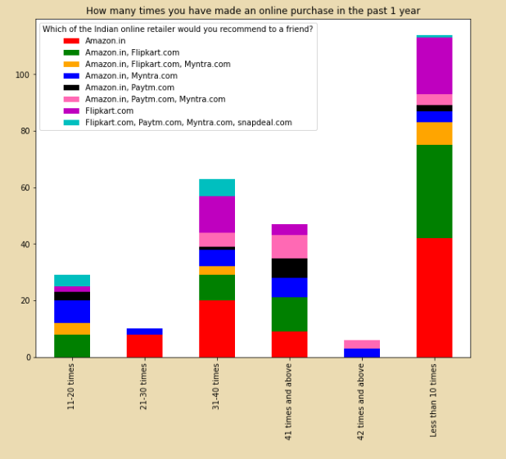
People who shop more than 41 times a year tend to recommend all platforms . Whereas the customers who shop less than 10 times a year are recommending Amazon.in and Flipkart .com on a large amount.

Slide 13

Conclusion:
All the websites were not equally preferred by online customers. Amazon was the most preferred followed by Flipkart. This can be explained easily by previous result that we got. These two companies are most trusted in the industry and hence, have a huge reliability. Also, the sellers listed on these websites are generally from Tier 1 cities as compared to Snapdeal and PayTM which have more sellers from tier 2 and 3 cities. Also, these websites have the most lenient return policies as compared to others and also the time required to process a return is low for these.

Slide 14

Thank You

